Slide 1


Ensemble Techniques– Day-1
AIML
POST GRADUATE PROGRAM
ARTIFICIAL INTELLIGENCE & MACHINE LEARNING

Slide 2
Learning Objectives
Learn Decision Tree method for modelling, understand its advantages and disadvantages
What is Ensemble method of modelling, it's advantages and disadvantages
Use of Decision Tree in Ensemble method
Bagging, Bootstrapping and Random Forest

Slide 3
Introduction to Decision Trees
Decision Tree based models are used for both classification and regression
It can be used both for binary and multi-class classification. For example, classify mail as spam, non spam (binary classification) and identify character of alphabet (multi class classification)
The relation between target / predicted variable and independent / predictor variable is expressed visually in the form of a binary tree
It is an acyclic graph that helps classify new observations

Slide 4
Introduction to Decision Trees
It breaks down dataset into smaller subset with increase in depth of tree
The tree structure consists of nodes (representing data) and branches (representing functions used to split the data)
Nodes are of three types –
  Root node - Represents the original entire training data
  Branch node - Data sets created from the main data through splitting using some function
  Leaf nodes - smallest datasets that are not split further

Slide 5
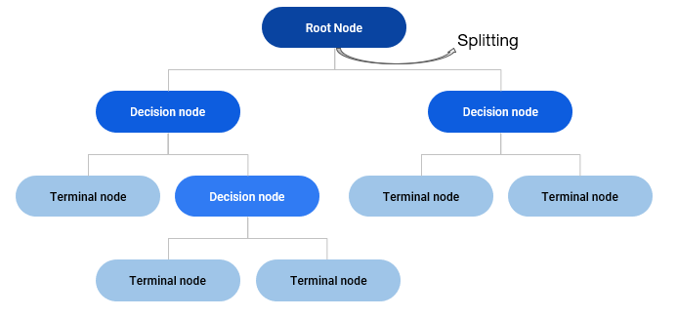
Introduction to Decision Trees
Branches represent logical functions used to split data into nodes
The objective is to obtain a tree where each leaf level node belongs to only one class of data

Slide 6
How it works?
Age | Income | Loan Status
52 | 1,50,000 | Rejected
28 | 89,000 | Approved
52 | 3,50,000 | Approved
26 | 35,000 | Approved
59 | 65,000 | Rejected
30 | 97,000 | Approved
36 | 45,000 | Rejected
34 | 56,000 | Rejected
28 | 78,000 | Approved
44 | 2,78,000 | Approved
This dataset consists of the customer information and their loan approval status
Let us understand that if the independent variables Age, Gender and Income have any impact on the target column ‘Loan status’
The target column has binary values Approved and Rejected

Slide 7
How it works?
Approved
Age | Income | Loan Status
52 | 1,50,000 | Rejected
28 | 89,000 | Approved
45 | 3,50,000 | Approved
30 | 97,000 | Approved
44 | 2,78,000 | Approved
Approved
Age | Income | Loan Status
52 | 1,50,000 | Rejected
28 | 89,000 | Approved
45 | 3,50,000 | Approved
30 | 97,000 | Approved
44 | 2,78,000 | Approved
Age | Income | Loan Status
52 | 1,50,000 | Rejected
28 | 89,000 | Approved
45 | 3,50,000 | Approved
26 | 35,000 | Approved
59 | 65,000 | Rejected
30 | 97,000 | Approved
36 | 45,000 | Rejected
34 | 56,000 | Rejected
28 | 78,000 | Approved
44 | 2,78,000 | Approved
Age | Income | Loan Status
52 | 1,50,000 | Rejected
28 | 89,000 | Approved
45 | 3,50,000 | Approved
26 | 35,000 | Approved
59 | 65,000 | Rejected
30 | 97,000 | Approved
36 | 45,000 | Rejected
34 | 56,000 | Rejected
28 | 78,000 | Approved
44 | 2,78,000 | Approved
Labelled as ‘Approved’ as per majority class in the Loan Status
Though the homogeneity in the target column is increased in the smaller nodes, there’s still a mix of both values.
Yes
Let’s split by
Income >80,000
No
Age | Income | Loan Status
26 | 35,000 | Approved
59 | 65,000 | Rejected
36 | 45,000 | Rejected
34 | 56,000 | Rejected
28 | 78,000 | Approved
Rejected
Labelled as ‘Rejected’ as per majority class in the Loan Status

Slide 8
How it works?
Rejected
Let’s further split by
Age | Income | Loan Status
52 | 1,50,000 | Rejected
Age | Income | Loan Status
52 | 1,50,000 | Rejected
28 | 89,000 | Approved
45 | 3,50,000 | Approved
30 | 97,000 | Approved
44 | 2,78,000 | Approved
Yes
Age
> 50
Age | Income | Loan Status
28 | 89,000 | Approved
45 | 3,50,000 | Approved
30 | 97,000 | Approved
44 | 2,78,000 | Approved
Approved
No
The nodes are now completely Homogenous and further splitting is not required
Age | Income | Loan Status
59 | 65,000 | Rejected
36 | 45,000 | Rejected
34 | 56,000 | Rejected
Rejected
Age | Income | Loan Status
26 | 35,000 | Approved
59 | 65,000 | Rejected
36 | 45,000 | Rejected
34 | 56,000 | Rejected
28 | 78,000 | Approved
Yes
Age
> 30
No
Approved
Age | Income | Loan Status
26 | 35,000 | Approved
28 | 78,000 | Approved

Slide 9
Formation of Tree
Root Node
Approved – 6
Rejected – 4
The relation between variables can be given as:
If Income > 80,000
If age > 50, then ‘reject’
Else ‘Approve’
If Income < 80,000
If age > 30 then ‘reject’
Else ‘Approve’
Income > 80,000
Approved – 4
Rejected – 1
Income < = 80,000
Approved – 2
Rejected – 3
Age >50
Approved – 0
Rejected – 1
Age <=50
Approved – 4
Rejected – 0
Age > 30
Approved – 0
Rejected – 3
Age <= 30
Approved – 2
Rejected – 0
Classifying a new observation:
Age = 31 | Income = 95,000 | Status = ?
Rejected
Approved
Rejected
Approved

Slide 10
Visualizing Decision Trees
In some distributions, decision trees can separate the classes better than simple linear models
Entire Data
Simple linear model
Dimension 2
<S1
>S1
S2
<S2
>S2
S3
S1
<S3
>S3
Dimension 1

Slide 11
Decision Tree Algorithms
ID3 (Iterative Dichotomiser 3) – developed by Ross Quinlan. Creates a multi branch tree at each node using greedy algorithm. Trees grow to maximum size before pruning
C4.5 succeeded ID3 by overcoming limitation of features required to be categorical. It dynamically defines discrete attribute for numerical attributes. It converts the trained trees into a set of if-then rules. Accuracy of each rule is evaluated to determine the order in which they should be applied
C5.0 is Quinlan’s latest version and it uses less memory and builds smaller rulesets than C4.5 while being more accurate
CART (Classification & Regression Trees) is similar to C4.5 but it supports numerical target variables and does not compute rule sets. Creates binary tree. Scikit uses CART

Slide 12
Decision Trees – Loss Function
The decision tree algorithm learns (i.e. creates the decision tree from the data set) through optimization of a loss function
The loss function represents the loss of impurity in the target column. The requirement here is to minimize the impurity in the target column as much as possible at the leaf nodes
For this we need to understand how to measure the purity of the target column

Slide 13
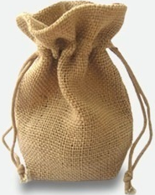
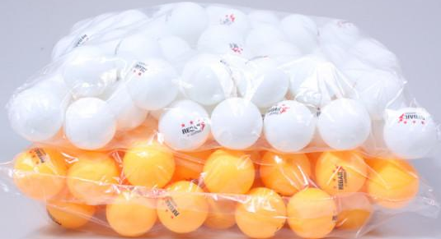

Uncertainty & Probability
Relation between uncertainty and probability
There is a bag of 50 balls of orange and white respectively
You have to pull out one ball from the bag with closed eyes. If the ball is -
  orange, explain the linear regression model
  white, nothing to be done
The state where one has to take decisions which can result in multiple outcomes with same probabilities is a state of maximum uncertainty
If you have a bag full of balls of only one colour, then there is no uncertainty. You know what is going to happen. Uncertainty is zero.
Thus, the more the homogeneity, lesser the uncertainty and vice versa
Uncertainty is expressed as entropy or Gini index

Slide 14
Entropy
Entropy … a measure of uncertainty
Given that there are multiple outcomes possible (orange or white) for a given action (picking the ball)
Given that we know the probability of getting each outcome (P(Orange) = .5 and P(White) = 1 - .5 = .5)
We also know that when only one outcome (White or Orange) is possible, there is no uncertainty. P(White = 1) and P(Orange = 1-1 = 0)
We can express the relation between uncertainty and probability of states in a mathematical form and give it a name Entropy or Gini

Slide 15

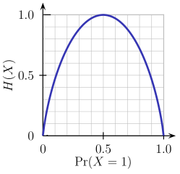
Shannon’s Entropy
Entropy … a measure of uncertainty
Imagine a bag contains 6 Orange and 4 White balls.
Let the two classes Orange -> class 0 and White -> class 1
Entropy of the bag (X) will be calculated as per the formula
  The index i refers to the number of classes possible
  H(X) = - (0.6 * log2( 0.6)) - (0.4 * log2(0.4)) = 0.9709506
Suppose we remove all Orange balls from the bag and then entropy will be
  H(X) = - 1.0 *log2(1.0) – 0.0 * log2(0) = 0 ## Entropy is 0! i.e. Information is 100%
This relation between probability and Entropy can be geometrically represented for a two class case as shown here

Slide 16
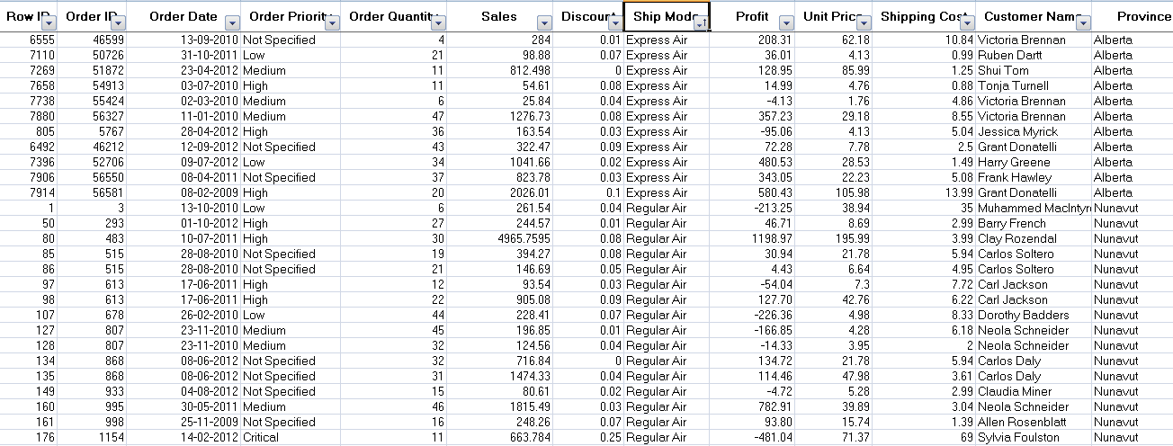
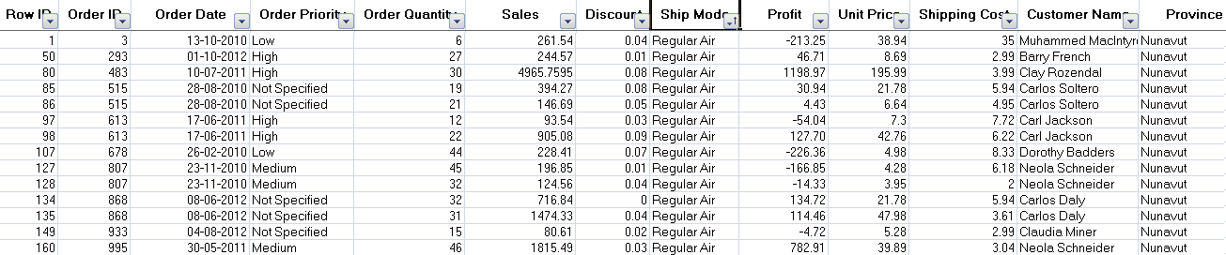
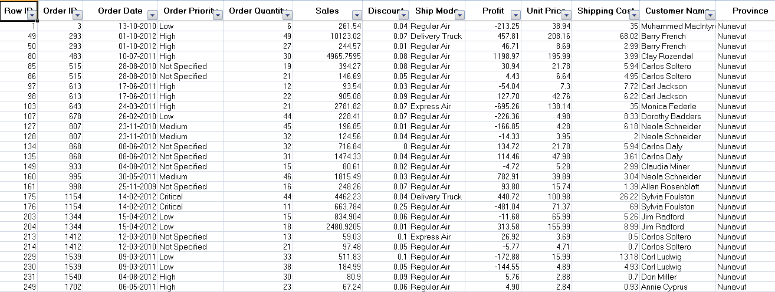
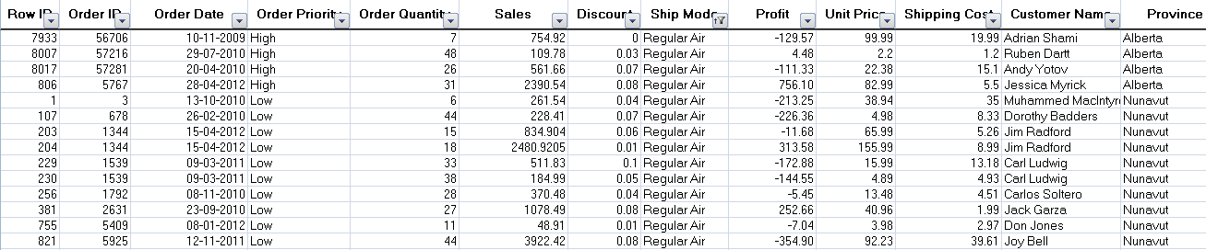
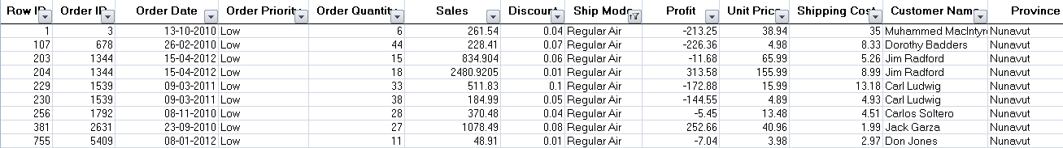
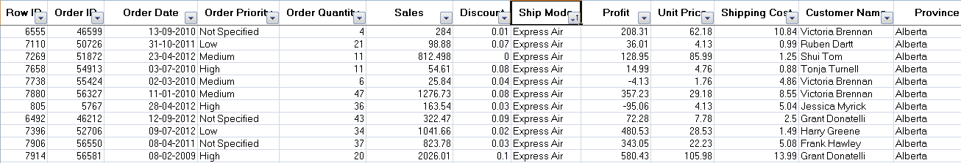
Entropy
Suppose we wish to find if there was any influence of shipping mode, order priority on customer location. Customer location is target column and like the bag of coloured balls
Shipping Mode
Sales
Data
Regular Air
Express Air
Low Priority
High Priority
When sub branches are created, the total entropy of the sub branches should be less than the entropy of the parent node. More the drop in entropy, more the information gained

Slide 17
Entropy & Information Gain
Entropy | Info Gain
E0 = max entropy say 1 | 0
E1 = (E1a*700/1000) + (E1b * 300/1000) | E0 – E1
E2 = (E2a * 500/700) + (E2b * 200/700) + (E2c * 100/300) + (E2d * 200/300) | E1 – E2
  Tree will stop growing when stop criterion for the splitting is reached which could be -
  Tree has reached certain pre-fixed depth (longestt path from root node to leaf node)
  Tree has achieve maximum number of nodes (tree size)
  Exhausted all attributes to split
  Leaf node on split will have less than predefined number of data points
Shipping
Mode (1000) E0
Regular Air (700), E1a
Express Air (300), E1b
Low Priority (500) E2a
High Priority (200) E2b
Low Priority (100) E2c
High Priority (200) E2d

Slide 18
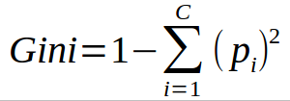
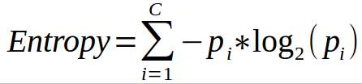
Common measures of impurity
Gini index – is calculated by subtracting the sum of the squared probabilities of each class from one
  Uses squared proportion of classes
  Perfectly classified, Gini Index would be zero
  Evenly distributed would be 1 – (1/# Classes)
  You want a variable split that has a low Gini Index
  Used in CART algorithm
Entropy –
  Favors splits with small counts but many unique values
  Weights probability of class by log(base=2) of the class probability
  A smaller value of Entropy is better. That makes the difference between the parent node’s entropy larger
  Information Gain is the Entropy of the parent node minus the entropy of the child nodes

Slide 19
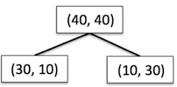




Information Gain using Entropy
Information Gain = reduction in entropy =

Slide 20



Information Gain using Gini Index
Information Gain = reduction in Gini index =

Slide 21
Pruning
Decision tree tends to get overfit with training sample and becomes too large and complex. A complex and large tree poorly generalizes the new samples data whereas a small tree fails to capture the information of training sample data.
Pruning may be defined as shortening the branches of tree. The process of reducing the size of the tree by turning some branch node into leaf node and removing the leaf node under the original branch.
Pruning is used to reduce size of a decision tree
It removes nodes that do not provide additional information

Slide 22
Hyperparameters for Decision Tree
Maximum Depth- the largest length between the root to leaf. A tree of maximum length k can have at most 2**k leaves.
Minimum number of samples per leaf- we can set a minimum for the number of samples we allow on each leaf.
Minimum sample split - the minimum number of samples required to split an internal node
Maximum features - the number of features that one looks for in each split.

Slide 23
Regularization
Decision Trees method does not expect data to have any particular type of distribution
Decision Trees are non parametric unlike Linear Regression which are defined using parameters for each predictor variable
Decision tree tries to fit the train data perfectly which leads to overfitting
To avoid overfitting, we need to restrict the DT’s freedom during the tree creation. This is called regularization

Slide 24
Regularization
The regularization hyperparameters depend on the algorithms used
max_depth – Is the maximum length of a path from root to leaf (in terms of number of decision points)
min_sample_split - A limit to stop further splitting of nodes when the number of observations in the node is lower than this value
min_sample_leaf – Minimum number of samples a leaf node must have. When a leaf contains too few observations, further splitting will result in overfitting (modeling of noise in the data).
min_weight_fraction_leaf – Same as min_sample_leaf but expressed in fraction of total number of weighted instances
max_leaf_nodes – maximum number of leaf nodes in a tree
max_feature_size - max number of features that are evaluated for splitting each node

Slide 25
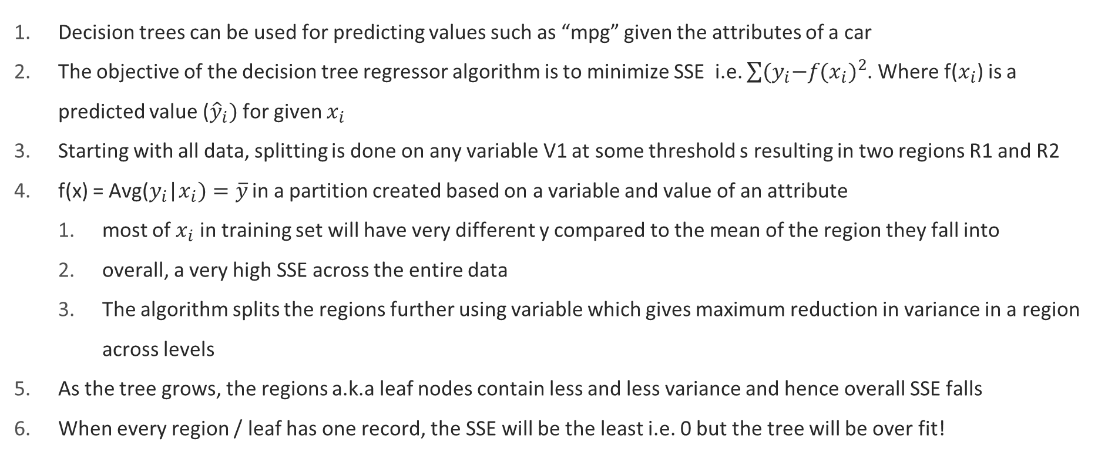
Decision Trees for Regression
Decision trees can be used for predicting values such as “mpg” given the attributes of a car
The objective of the decision tree regressor algorithm is to minimize SSE i.e. $\sum{{{(y}_{i}−f(x_{i})}^{2}}$. Where f($x_{i}$) is a predicted value (${\hat{y}}_{i})$ for given $x_{i}$
Starting with all data, splitting is done on any variable V1 at some threshold s resulting in two regions R1 and R2
f(x) = Avg($y_{i}$|$x_{i})=\overline{y}$ in a partition created based on a variable and value of an attribute
  most of $x_{i}$ in training set will have very different y compared to the mean of the region they fall into
  overall, a very high SSE across the entire data
  The algorithm splits the regions further using variable which gives maximum reduction in variance in a region across levels
As the tree grows, the regions a.k.a leaf nodes contain less and less variance and hence overall SSE falls
When every region / leaf has one record, the SSE will be the least i.e. 0 but the tree will be over fit!

Slide 26
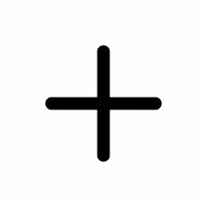
Decision Trees for Regression
Average of y for R2
The sum of the square of the difference of yi from ave(y) in a region is the SSE of the regions
The total SSE is highest in the root node i.e. for the entire data
Total SSE starts decreasing with splitting
Y (target variable)
S2
Region 2
Region 1
S1
Dimension 1

Slide 27
Decision Trees for Regression
Average of y for R1
Average of y for R2A
Y (target variable)
Total SSE (summed across all regions) minimizes with increase in partitions
Total SSE will be zero when every data point is a region. This will lead to over fit
S2
Average of y for R2B
Region 2B
Region 1
S1
Dimension 1

Slide 28
Advantages vs Disadvantages
Advantages | Disadvantages
Simple, Fast in processing and effective Does well with noisy data and missing data Handles numeric and categorical variables Interpretation of results does not required mathematical or statistical knowledge Draws non-linear boundaries thus can handle complex distributions relatively easily | Often biased towards splits or features have large number of levels May not be optimum as modelling some relations on axis parallel basis is not optimal Small changes in training data can result in large changes to the logic Decision trees tend to become overfit by default creating large complex trees Large trees can be difficult to interpret

Slide 29
Ensemble Methods - Introduction
Ensemble is a group of models that are used together for prediction both in classification and regression cases
Why do we need ensemble? We wish to build a highly accurate and generalizable model
We employ various methods to achieve this for e.g. tuning hyper parameters, up-sampling/ down-sampling etc.
Ensemble is another way of getting the high accuracy in prediction. Rather than create a single highly accurate model (thru delicate fine tuning), generate a set of models and predict by aggregating the output of all the models
The motivation behind ensemble is the belief that a committee of experts working together are more likely to be accurate than individual experts
The same belief is applied here. A group of predictors (may not be strong predictors), together become strong predictors

Slide 30


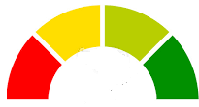


Ensemble Methods - Introduction
Training Data
Individual models are not good predictors
M1
. . .
Test Data
M2
M3
Mk
Training Data
Ensemble of models become strong predictors
Test Data
M1
. . .
M2
M3
Mk
Note: The Ensemble prediction is not some kind of average or max of individual predictors

Slide 31
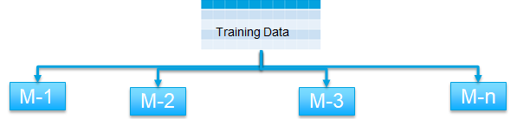
Ensemble Methods – Characteristics
For effective ensemble we have to ensure -
  The models are as different from each other as possible
  The errors of each model should be independent i.e. should not correlate
  Each model can be weak predictor (slightly better than random) but not poor predictor
The models in the ensemble
  Are not regularized and hence each model tend to overfit prone to variance errors
  The variance errors across all models put together cancel out at the time of aggregation / voting
  As a result, ensemble helps hit two birds with same stone! Each model has low bias error and with the variance errors cancelling out at ensemble level lead to low variance and bias errors at ensemble level
Ensemble
Legend
Error
Bias Error
Complexity

Slide 32
Two families of Ensemble Methods
Averaging methods, the driving principle is to build several estimators independently and then to average / vote their predictions. On average, the combined estimator is usually better than any of the single base estimator because its variance is reduced.
    E.g. Bagging methods, Forests of randomized trees, ...
Boosting methods, base estimators are built sequentially and one tries to reduce the bias of the combined estimator. The motivation is to combine several weak models to produce a powerful ensemble. E.g. AdaBoost, Gradient Tree Boosting, ...

Slide 33
Bagging – Bootstrap Aggregation
Designed to improve the stability (small change in dataset change the model) and accuracy of classification and regression models
It reduces variance errors and helps to avoid overfitting at ensemble level
Can be used with any type of machine learning model, mostly used with Decision Tree
Uses sampling with replacement to generate multiple samples of a given size. Sample may contain repeat data points
For large sample size, sample data is expected to have roughly 63.2% unique data points and the rest being duplicates
For classification bagging is used with voting to decide the class of an input while for regression average or median values are calculated

Slide 34

How it should be built?
Ideal Condition
Get multiple samples from the universe and train each model separately
Universe
Create the ensemble of models. Each model is independent and errors are not correlated
. . .
Training Data 1
Training Data 2
Training Data 3
Training Data k
. . .
M1
M2
M3
Mk
Multi-sampling is usually not an option
. . .
M1
M2
M3
Mk

Slide 35
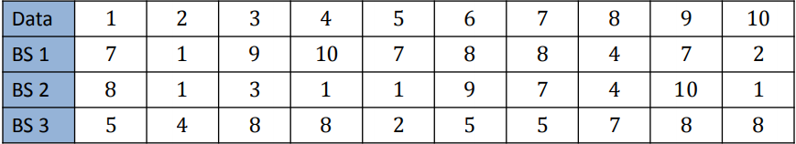
Bootstrap Sampling
Need to create different models from the same sample. How ?
Solution – Bootstrap sampling or sampling with replacement
  Take original sample of size n number of records / data points. For e.g. n = 10
  Create n bootstrap samples of size n from the original sample using random function (sampling with replacement). For e.g. –
Each bootstrap sample BSi (where i is index number) will be different from other bootstrap samples. They will not be mirror images
Each bootstrap sample may have repeating records
Each bootstrap sample represents sample from universe

Slide 36
How it is built?
Reality
Universe
Get the original sample
Use bootstrap sampling to create k multiple data sets
Create the ensemble of models.
Models are not really independent and errors are likely to be correlated
Training Data (N)
. . .
B.Sample 1
B.Sample 2
B.Sample 3
B.Sample k
. . .
M1
M2
M3
Mk
. . .
M1
M2
M3
Mk

Slide 37


Bagging – How does it work?
Once an ensemble has been built, each instance is given the test record to work on
If the problem is classification, each instance classifies the record. Some will mis-classify and other will correctly do so
The classifications are sent through a voting process where the majority wins
To prevent ties, the number of models in an ensemble should be odd. If the number is even, a random function will be used to break the tie
Classification:
Regression:
Test Record
Test Record
M1
. . .
M1
. . .
M2
M3
Mk
M2
M3
Mk
No
Yes
No
No
20
15
17
22
No
18.5

Slide 38
Random Forest
Each tree in the ensemble is built from a sample drawn with replacement (bootstrap) from the training set
In addition, when splitting a node during the construction of a tree, the split that is chosen is no longer the best split among all the features
Instead, the split is picked is the best split among a random subset of the features
As a result of this randomness, the bias of the forest usually slightly increases (with respect to the bias of a single non-random tree)
Due to averaging, its variance decreases, usually more than compensating the increase in bias, hence yielding overall a better result
Source: scikit-learn user guide , chapter 3 , page 231

Slide 39

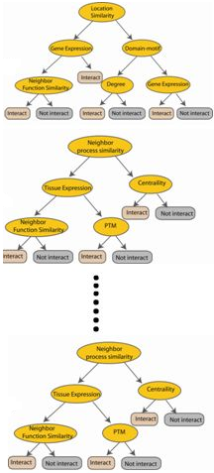



Random Forest
Randomly selected sub feature set
Independent trees created in parallel
Used with Decision Trees.
Create different trees by providing different sub-features from the feature set to the tree creating algorithm.
The optimization function is Entropy or Gini index
N instances
Original number of features

Slide 40

Questions?

